Slide 1



© Frank Mueller & Seokyong Hong (TA)
North Carolina State University
Center for Efficient, Secure and Reliable Computing
Android Application Model (3)
Except as otherwise noted, the content of this presentation is
licensed under the Creative Commons Attribution 2.5 License.
Notes:
1

Slide 2
Android Application Package
Android applications are written in Java.
An Android application is bundled by the aapt tool into an Android package (.apk)
.apk
Java Code
Data Files
res/layout: declaration layout files
res/drawable: intended for drawing
res/admin: bitmaps, animations for transitions
res/values: externalized values
    strings, colors, styles, etc
res/xml: general XML files used at runtime
res/raw: binary files (e.g. sound)
Resources
Files

Slide 3
Application Components
Android applications do not have a single entry point (e.g. no main() function).
They have essential components that the system can instantiate and run as needed.
Four basic components
Components | Description
Activity | UI component typically corresponding to one screen
Service | Background process without UI
Broadcast Receiver | Component that responds to broadcast Intents
Content Provider | Component that enables applications to share data

Slide 4
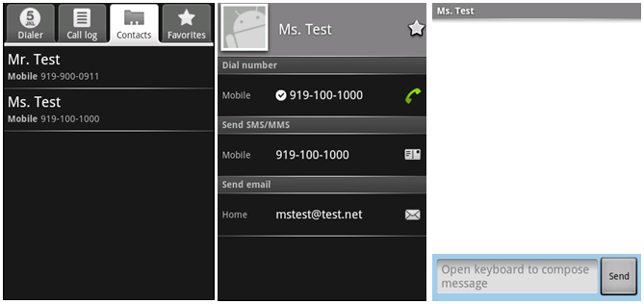
Components - Activity
An activity is usually a single screen:
  Implemented as a single class extending Activity.
  Displays user interface controls (views).
  Reacts on user input/events.
An application typically consists of several screens:
  Each screen is implemented by one activity.
  Moving to the next screen means starting a new activity.
  An activity may return a result to the previous activity.

Slide 5

Components - Activity (Cont)
Typically, one of the activities is marked as the first one that should be presented to the user when the application is launched.
Created “Activity” must be defined into the application’s manifest.

Slide 6

Components - Service
A service does not have a visual user interface, but rather runs in the background for an indefinite period time.
Example: music player, network download, etc
Each service extends the Service base class.
It is possible to bind to a running service and start the service if it's not already running.
While connected, it is possible communicate with the service through an interface defined in an AIDL (Android Interface Definition Language).
Notification
Service
Communication
Pause/rewind
/stop/restart
Background running
for playback
Media Player
Activity
Binder

Slide 7
Components - Service (Cont)
Adding a "Service" with Android is quite similar than for an "Activity".

Slide 8

Components - Broadcast Receivers
A broadcast receiver is a component that receives and reacts to broadcast announcements (Intents).
  Many broadcasts originate in system code.
E.g. announcements that the time zone has changed, that the battery is low, etc.
Broadcast Receiver
Activity
Get incoming calls
Get incoming SMS
SMS

Slide 9
Components - Broadcast Receivers (Cont)
A broadcast receiver is a component that receives and reacts to broadcast announcements. (Cont)
  Applications can also initiate broadcasts.
    E.g. to let other applications know that some data has been downloaded to the device and is available for them to use.
All receivers extend the BroadcastReceiver base class.

Slide 10

Components - Content Providers
Application
Activity
Activity
Application
Application
Activity
Content Resolver
Service
Content Resolver
Content Provider
Content Resolver
Data
XML
SQLite
Remote
Store
A content provider makes a specific set of the application's data available to other applications.
  The data can be stored in the file system, in an SQLite, or in any other manner that makes sense.

Slide 11
Components - Content Providers (Cont)
Using a content provider is the only way to share data between Android applications.
It extends the ContentProvider bas class and implements a standard set of methods to allow access to a data store.
  Querying
  Delete, update, and insert data
Applications do not call these methods directly.
  They use a ContentResolver object and call its methods instead.
  A ContentResolver can talk to any content provider.
Content is represented by URI and MIME type.

Slide 12
Intents
Intents are simple message objects each of which consists of
  Action to be performed (MAIN/VIEW/EDIT/PICK/DELETE/DIAL/etc)
  Data to operate on (URI)
startActivity(new Intent(Intent.VIEW_ACTION, Uri.parse("http://www.fhnw.ch"));
startActivity(new Intent(Intent.VIEW_ACTION, Uri.parse("geo:47.480843,8.211293"));
startActivity(new Intent(Intent.EDIT_ACTION,Uri.parse("content://contacts/people/1"));

Slide 13
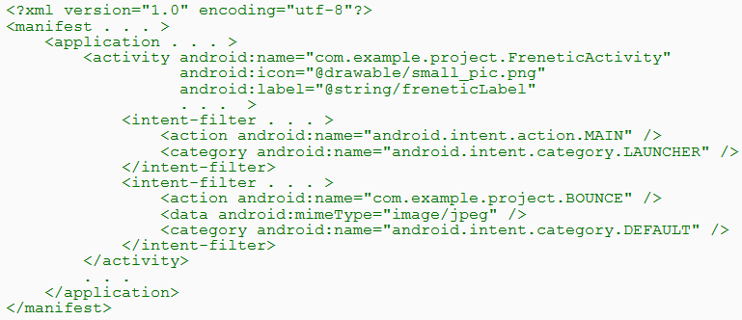
Intents (Cont)
Intent Filters
  A component's intent filters in the manifest file inform Android of the kinds of intents the component is able to handle.
  An example

Slide 14
Intents (Cont)
Intent Filters (Cont)
  An example (Cont)
    A component can have any number of intent filters, each one declaring a different set of capabilities.
    The first filter in the example indicates that the activity is the entry point for the application.
    The second filter declares an action that the activity can perform on a particular type of data.

Slide 15
Android Component Model
An Android application is packaged in a .apk file.
  A .apk file is a collection of components.
  Components share a Linux process: by default, one process per .apk file.
  .apk files are isolated and communicate with each other via Intents or AIDL.
  Every component has a managed lifecycle.
Application (.apk)
Process
Activity
Activity
Activity
Activity
Content Provider
Service
Service

Slide 16
Activities and Tasks
One activity can start another, including one defined in a different application.
②
Activity
Activity
Asynchronous Message (Intent)
①
Context.startActivity(Intent)
or
Activity.startActivityForResult
(Intent, Request_Code)
No return
To get some result
(e.g. to get a photo)

Slide 17
Activities and Tasks (Cont)
Tasks
  A task is a collection of related Activities.
  It is capable of spanning multiple processes.
Application (.apk)
Application (.apk)
Process
Process
Activity
Activity
Activity
Activity
Activity
Activity
Activity
Activity
Content Provider
Content Provider
Service
Service
Service
Service

Slide 18
Activities and Tasks (Cont)
Tasks (Cont)
  All activities in a task are arranged in a stack.
  If one activity starts another, the new activity is pushed on the stack and it becomes the running activity.
  When the user presses the BACK key, the current activity is popped from the stack and the previous one resumes.
Instance of Activity B
The one that's currently running
Instance of Activity C
Instance of Activity B
Instance of Activity A
The one that began the task (typically, an activity the user selected in the application launcher)
A Stack

Slide 19
Activities and Tasks (Cont)
Affinities
  An affinity means a preference for each activity to belong to a certain task.
  An individual affinity can be set for each activity:
  By default, a new activity is launched into the task of the activity that called startActivity().

Slide 20
Activities and Tasks (Cont)
Affinities (Cont)
  Two circumstances where the affinity comes into play:
    FLAG_ACTIVITY_NEW_TASK flag
If the Intent object passed to startActivity() contains the FLAG_ACTIVITY_NEW_TASK flag, the system looks for a different task to house the new activity.
      If there's already an existing task with the same affinity as the new activity, the activity is launched into that task.
      If not, it begins a new task.
  allowTaskReparenting attribute
If an activity has its allowTaskReparenting attribute set to "true", it can move from the task it starts in to the task it has an affinity for when that task comes to the fore.

Slide 21
Activities and Tasks (Cont)
Launch Modes
  There are four launch modes:
standard (default) / singleTop / singleTask / singleInstance
  A launch mode can be set for each activity:

Slide 22
Activities and Tasks (Cont)
Launch Modes (Cont)
  The modes differ from each other on four points:
    Which task will hold the activity that responds to the intent
Original Task
Original Task
New Task
New Activity
Activity A
Activity A
Root Activity
Root Activity
New Activity
standard/singleTop
without FLAG_ACTIVITY_NEW_TASK
singleTask/singleInstance

Slide 23
Activities and Tasks (Cont)
Launch Modes (Cont)
  The modes differ from each other on four points: (Cont)
    Whether there can be multiple instances of the activity
      A "standard" or "singleTop" activity can be instantiated many times.
      A "singleTask" or "singleInstance" activity is limited to just one instance.
Task A
Task B
Task A
Task B
Activity B
Activity C
Activity B
Activity C
Activity B
Activity A
Activity D
Activity A
Activity C
Activity B and Activity C are
standard/singleTop
Activity C is singleTask or singleInstance

Slide 24
Activities and Tasks (Cont)
Launch Modes (Cont)
  The modes differ from each other on four points: (Cont)
    Whether the instance can have other activities in its task
"standard" | These modes permit multiple activities to belong to the task. A "singleTask" activity will always be the root activity of the task.
"singleTop"
"singleTask"
"singleInstance" | An activity stands alone as the only activity in its task.

Slide 25
Activities and Tasks (Cont)
Launch Modes (Cont)
  The modes differ from each other on four points: (Cont)
    Whether a new instance of the class will be launched to handle a new intent
Activity D
Activity D
Activity D
Activity D
The existing instance D is expected to handle the new intent (since it's at the top of the stack)
An intent arrives for an activity of type D
Activity C
Activity C
Activity C
Activity B
Activity B
Activity B
Activity A
Activity A
Activity A
Original Task
If D is"standard"
If D is"singleTop"

Slide 26
Activities and Tasks (Cont)
Launch Modes (Cont)
  The modes differ from each other on four points: (Cont)
    Whether a new instance of the class will be launched to handle a new intent (Cont)
Activity B
Activity B
Activity D
Activity D
Activity D
The existing instance B is not expected to handle the new intent (since it's not at the top of the stack)
An intent arrives for an activity of type B
Activity C
Activity C
Activity C
Activity B
Activity B
Activity B
Activity A
Activity A
Activity A
Original Task
If B is"standard"
If B is"singleTop"

Slide 27
Activities and Tasks (Cont)
Launch Modes (Cont)
  The modes differ from each other on four points: (Cont)
    Whether a new instance of the class will be launched to handle a new intent (Cont)
A "singleInstance" activity is always at the top of the stack, so it is always in position to handle the intent.
An intent arrives for an activity of type B
Activity B
Activity B
Original Task
If B is"singleInstance"

Slide 28
Activities and Tasks (Cont)
Launch Modes (Cont)
  The modes differ from each other on four points: (Cont)
    Whether a new instance of the class will be launched to handle a new intent (Cont)
Activity B
Activity B
Activity B can handle the intent since it is in position.
An intent arrives for an activity of type B
Activity A
Activity A
Original Task
If B is"singleTask"
Activity A
Activity A
Activity B cannot handle the intent since it is not in position and the intent is dropped.
An intent arrives for an activity of type B
Activity B
Activity B
Original Task
If B is"singleTask"

Slide 29
Activities and Tasks (Cont)
Clearing the Stack
  Default Control
If the user leaves a task for a long time, the system clears the task of all activities except the root activity.
  Some activity attributes that can be used to modify the default control:
    If alwaysRetainTaskState is set to the root activity of a task
      The task retains all activities in its stack even after a long period.
    If clearTaskOnLaunch is set to the root activity of a task
      The stack is cleared down to the root activity whenever the user leaves the task and returns to it.
      The user always returns to the task in its initial state, even after a momentary absence.

Slide 30
Activities and Tasks (Cont)
Clearing the Stack (Cont)
  Some activity attributes that can be used to modify the default control: (Cont)
    If finishOnTaskLaunch is set to an activity of a task
      - The activity remains part of the task only for the current session.
      - If the user leaves and then returns to the task, it no longer is present.
  Another way to force activities to be removed from the stack (FLAG_ACTIVITY_CLEAR_TOP flag):
    If an intent includes the FLAG_ACTIVITY_CLEAR_TOP flag and the target task already has an instance of the type of activity that should handle the intent in its stack, all activities above that instance are cleared away.

Slide 31
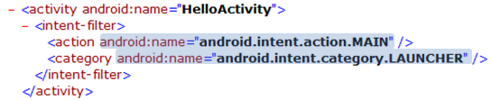
Activities and Tasks (Cont)
Starting Tasks
  How to set up an activity as the entry point of a task

Slide 32
Processes and Threads
Processes
  When the first of an application's components needs to be run, Android starts a Linux process for it with a single thread of execution (Main Thread).
  Android may decide to kill a process to reclaim resources.
Application (.apk)
1
Process
1
Main Thread

Slide 33
Processes and Threads (Cont)
Process (Cont)
  We can specify a process where an individual component should run by setting a process name to “process” attribute of <activity>, <service>, <receiver>, or <provider>.
    Each component can run in its own process.
    Some components share a process while others do not.
    Components of different applications also can run in the same process.
  We can set a default value that applies to all components by setting a default process to "process attribute of <application>.

Slide 34
Processes and Threads (Cont)
Threads
  Main Thread
    All components are instantiated in the main thread of the specified process.
    System calls to the components are dispatched from the main thread.
      Methods that respond to those calls always run in the main thread of the process.
      No component should perform long or blocking
      operations (e.g. network downloads, computation loops)

Slide 35
Processes and Threads (Cont)
Threads (Cont)
  Anything that may not be completed quickly should be assigned to a different thread.
    Threads are created in code using standard Java Thread objects.
  Some convenience classes Android provides for managing threads:
    Looper for running a message loop within a thread
    Handler for processing messages
    HandlerThread for providing a handy way for starting a new thread that has a looper

Slide 36
Component Lifecycles
Activity Lifecycle
  Three states
    If an activity is paused or stopped, the system can drop it from memory either by:
      asking it to finish (calling its finish() method)
      simply killing its process.
State | Description
Running | An activity is in the foreground of the screen (at the top of the activity stack for the current task).
Paused | An activity has lost focus but is still visible to the user.
Stopped | An activity is completely obscured by another activity. It still retains all state and member information.

Slide 37
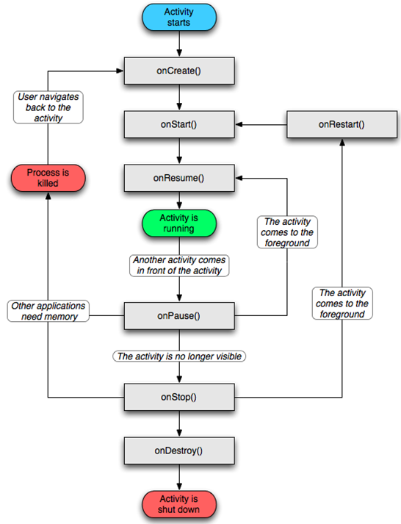
Component Lifecycles
Activity Lifecycle (Cont)
  An activity's overall lifecycle
    onCreate()
      Called when the activity is first created or when the activity was killed
    onStart()
      Called just before the activity becomes visible to user
    onRestart()
      Called after the activity has been stopped, just prior to it being started again

Slide 38
Component Lifecycles (Cont)
Activity Lifecycle (Cont)
  An activity's overall lifecycle (Cont)
    onResume()
      Called just before the activity starts interacting with the user
      At this point, the activity is at the top of the activity stack, with user input going to it.
    onPause()
      Called when the system is about to start resuming another activity
      This method is typically used to commit unsaved changes to persistent data, stop animations and other things that may be consuming CPU, and so on.

Slide 39
Component Lifecycles (Cont)
Activity Lifecycle (Cont)
  An activity's overall lifecycle (Cont)
    onStop()
      Called when the activity is no longer visible to the user
      This may happen because it is being destroyed, or because another activity has been resumed and is covering it.
    onDestroy()
      Called before the activity is destroyed

Slide 40
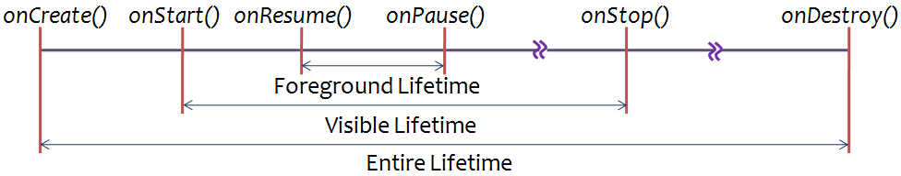
Component Lifecycles (Cont)
Activity Lifecycle (Cont)
  Three nested loops for the entire lifecycle
    Visible Lifetime
      During this time, the user can see the activity on-screen, though it may be in the foreground and interacting with the user.
      onStart() and onStop() can be called multiple times, as the activity alternates between being visible and hidden to the user.
    Foreground Lifetime
      During this time, the activity is in front of all other activities on screen and is interacting with the user.

Slide 41
Component Lifecycles (Cont)
Service Lifecycle
  Two ways that a service can be used
    The service can be started and allowed to run until someone stops it or it stops itself.
      started by calling Context.startService() and stopped by calling Context.stopService()
    The service can be operated programmatically using an interface that it defines and exports.
      Clients establish a connection to the Service object and use that connection to call into the service.
      established by calling Context.bindService() and closed by calling Context.unbindService()

Slide 42
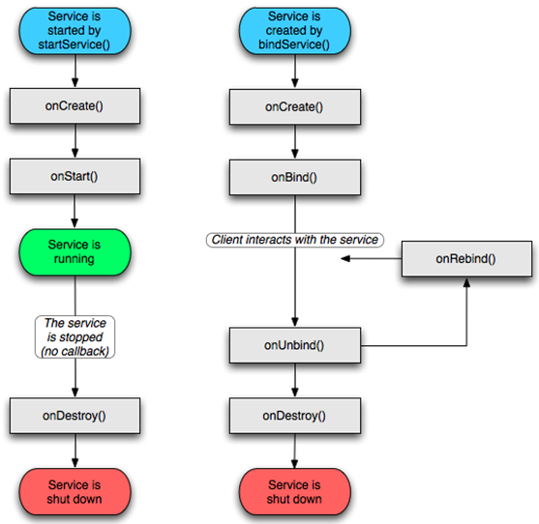
Component Lifecycles (Cont)
Service Lifecycle (Cont)

Slide 43
Component Lifecycles (Cont)
Broadcast Receiver Lifecycle
  Only single callback method
  void onReceive(Context curContext, Intent broadcastMsg)
    When a broadcast message arrives for the receiver, Android calls the method and passes it the Intent object containing the message.
  A process with an active broadcast receiver is protected from being killed but a process with only inactive components can be killed by the system at any time.

Slide 44
Component Lifecycles (Cont)
Processes and Lifecycles
  Android tries to maintain a process for as long as possible, but eventually it will need to remove old processes when memory runs low.
    To determine candidates to be killed, Android places each process into an "importance hierarchy" based on the components running in it and the state of those components.

Slide 45
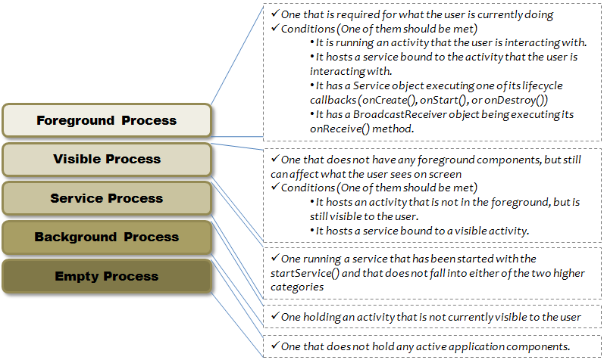
Component Lifecycles (Cont)
Processes and Lifecycles (Cont)
  Five levels in the Importance Hierarchy

